Slide 1


Slide 2
Self-Introduction Speech
2
It is required in seminars, business meetings, and anywhere you need to speak. It shortly describes your interests, goals, and skills. Usually, you have 2-3 minutes for it. 🞑 Elevator-speech: it is about 30 seconds!

Slide 3
Self Introduction
3 | General: General background/information, and favorites Academic: education background, work experience, research interests, and personal qualities

Slide 4
 | Steps to make a Self-Introduction
Stating Your name clearly Placing yourself Where you are from, Organization you belong to, your current position Background Purpose of the meeting, related experience, … Academic/Career goals Sharing personal details Hobbies/interests Mostly, in first meetings to get acquainted with new people and find someone with similar interests Conclusion

Slide 5
Basic questions to answer
5 | What is your name? Where are you come from? What are your hobbies? What are you doing now? What is your major in your undergraduate program? What are your favorite subjects? What is your specialty (skill)?

Slide 6
 | General form of answers
My name is . I am from . My hobby is . I like . I do not like . I am studying .

Slide 7
General self introduction: Example 1
7 | Hello every body, I would like to introduce myself. My name is Hassan, and I am from Iran. I am studying at the university of Kurdistan as an undergraduate student in Electrical Engineering. There are seven people in my family: I have two brothers and two sisters. My favorite foods are Rice and Mushroom. My favorite sports are Football and Swimming. My favorite season is Spring because the world is colorful and the weather is comfortable. My favorite color is Green, like the grass, vegetables, and kiwi fruit. In my free time I like to play computer games.

Slide 8
 | General self introduction: Example 2
Hello everyone. My name is Hassan. I am a student of Electrical Engineering at the University of Kurdistan. Now, let me talk about my interests. First of all, I like listening to classical music. I have about 100 music CDs at home, and I listen to music almost every evening. I also like photography. I grew up in a small village located in the southern part of Sanandaj. My village is famous for its production of fruits. Before I conclude my self-introduction, let me tell you about my personality. I am a very friendly person, so I am very easy to talk to. I hope to make many friends at this university. Thank you.

Slide 9
General self introduction: Example 3
9
Hi everybody! I'm Masie Smith, Senior Marketing Executive, from Watts and Frederick in Smalltown, Bigstate. It's great to be finally here. I've been dreaming about the opportunity and possibilities of working collectively and directly with each other for a long time now. Jane and Sam can attest to that. There's been hours put in balancing the schedules to make it happen. Webinars and email are fine but nothing beats face to face. Working like this has always been a passion. Even in kindergarten I tried to set up a group-think session around a one swing and ten children problem. Years later my master degree focused on harnessing group energy creatively. I've been inspired by agencies that got it right. Sally you've already said it and I echo you. I'm excited!
http://www.write-out-loud.com/self-introduction-speech.htm

Slide 10
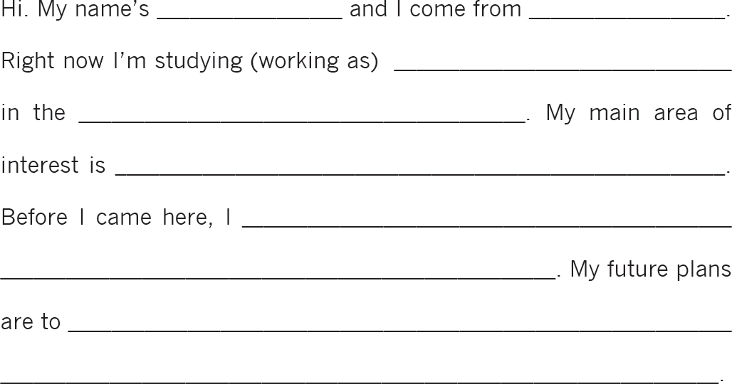
Academic Self Introduction: Example 1
10
Susan M. Reinhart, Giving Academic Presentations, 2nd Edition, University of Michigan Press, 2013.

Slide 11

13

